Slide 1
ARDUINO PEDOMETER- COUNTS YOUR STEPS
SUBMITTED BY
AYUSHI YADAV (1903480310015)
DIVYA SHUKLA (1903480310021)
DIVYANSHI TRIPATHI (1903480310016)
GAURAV GUPTA (1903480310017)

Slide 2
introduction
As technology keeps developing so does our need to not only live longer but also in more healthy and comfortable way.
Fitness bands are getting very popular nowadays.
Those bands not only counts the footsteps but also keeps tracking calories burned, display heartbeat rate, show time and many more which are synced directly with cloud on smartphone.

Slide 3
Objectives
The project “Pedometer” is developed with the purpose that is able to measure the steps done at different speed.
This pedometer must be also able to discard “fake movement” such as jumping.
A device keeps track on physical activity (number of steps).

Slide 4
Concept
A pedometer or a step- counter is a portable device that counts each step a person takes by detecting the motion of a body part.
The total number of steps taken by a person is calculated using three components of motion that are forward, vertical and side.
The pedometer system uses an accelerometer to get these values.
The average value of these 3- axis (Max + Min)/2, is called dynamic threshold level, and this threshold value is used to decide whether the step is taken or not.

Slide 5
Hardware required
Arduino Mega
ADXL 335 Accelerometer
16x2 LCD
Battery

Slide 6
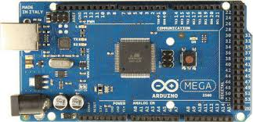
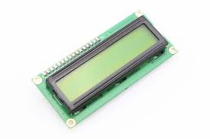
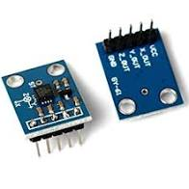
Hardware required

Slide 7
Application
Beneficial to the part of society where fashion style weighted over health.
Helpful for maintaining and tracking physical activity.
Motivates people towards healthier society.

Slide 8
limitations
They are not much beneficial in comparing different age group of people.
In competition, there is chance of tempering by participants.
Sometime don’t accurate result while jogging or running. Hence assessment is restricted to walking (movement).

Slide 9
Cost analysis
The total expenditure of the project is around Rs 1300.
Arduino Mega Rs 700
ADXL 335 Accelerometer Rs 250
LCD 16x2 Rs 150
Battery 9V Rs 50
Jumper wire Rs 50
Bread Board Rs 100

Slide 10
CONCLUSION
A significant portion of people live in a sedentary way, away from physical practices and healthy lifestyle habits.
It is necessary to recognize physical activity as an important element for normal metabolic activities as well as reducing the risks of future diseases.
With this conclusion, our group has made a prototype device that helps in this matter, collecting data that can be used and analysed in a more detailed way.

Slide 11
bibliography
“Pedometer (Arduino 101)” [Online]. Available: https://create.arduino.cc/projecthub/brudarko/pedometer-arduino-101-ef494b
“DIY Arduino Pedometer – Counting Steps using Arduino and Accelerometer” [Online]. Available: https://circuitdigest.com/microcontroller-projects/diy-arduino-pedometer-counting-steps-using-arduino-and-accelerometer
Mohanty S., Joshi A., Mishra B. “PEDOMETER”. Available: https://www.ee.iitb.ac.in/course/~wel/wel45/public_html/edl08a/edl08a_d09.pdf
Gil S., Gaitan M., Tobajas A., Benito A. “PEDOMETER REPORT”

